Slide 1
WELCOME!
We are so glad that you are here.
Missouri Coordinated School Health Conference
Notes:
https://jamboard.google.com/d/1vGIp4hM9GrDGkHcDTuTF3OohfBl5oscKmGiRV4dVX7M/edit?usp=sharing

Slide 2
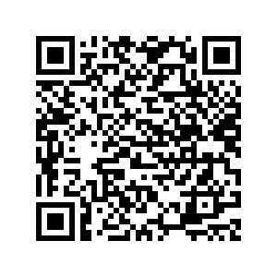
Busting through Burnout: Strategies to Promote Systems-Level Support of Educator Well-Being
Erika Franta, PhD Hannah West, PhD, BCBA

Slide 3
Disclaimer
This presentation was prepared for the MHTTC Network under a cooperative agreement from the Substance Abuse and Mental Health Services Administration (SAMHSA). All material appearing in this presentation, except that taken directly from copyrighted sources, is in the public domain and may be reproduced or copied without permission from SAMHSA or the authors. Citation of the source is appreciated. Do not reproduce or distribute this presentation for a fee without specific, written authorization from the MHTTC Network Coordinating Office. This presentation will be recorded and posted on our website.
At the time of this publication, Miriam Delphin-Rittmon served as Assistant Secretary for Mental Health and Substance Use and Administrator of SAMHSA. The opinions expressed herein are the views of the speakers and do not reflect the official position of the Department of Health and Human Services (DHHS), or SAMHSA. No official support or endorsement of DHHS, SAMHSA, for the opinions described in this presentation is intended or should be inferred.
This work is supported by grants under Funding Opportunity Announcement (FOA) No. SM-18-015 from the DHHS, SAMHSA.
Since we are federally funded, we will have you complete a brief survey at the end of the session. This is different from the conference feedback survey. Please complete both, as we value your feedback.

Slide 5
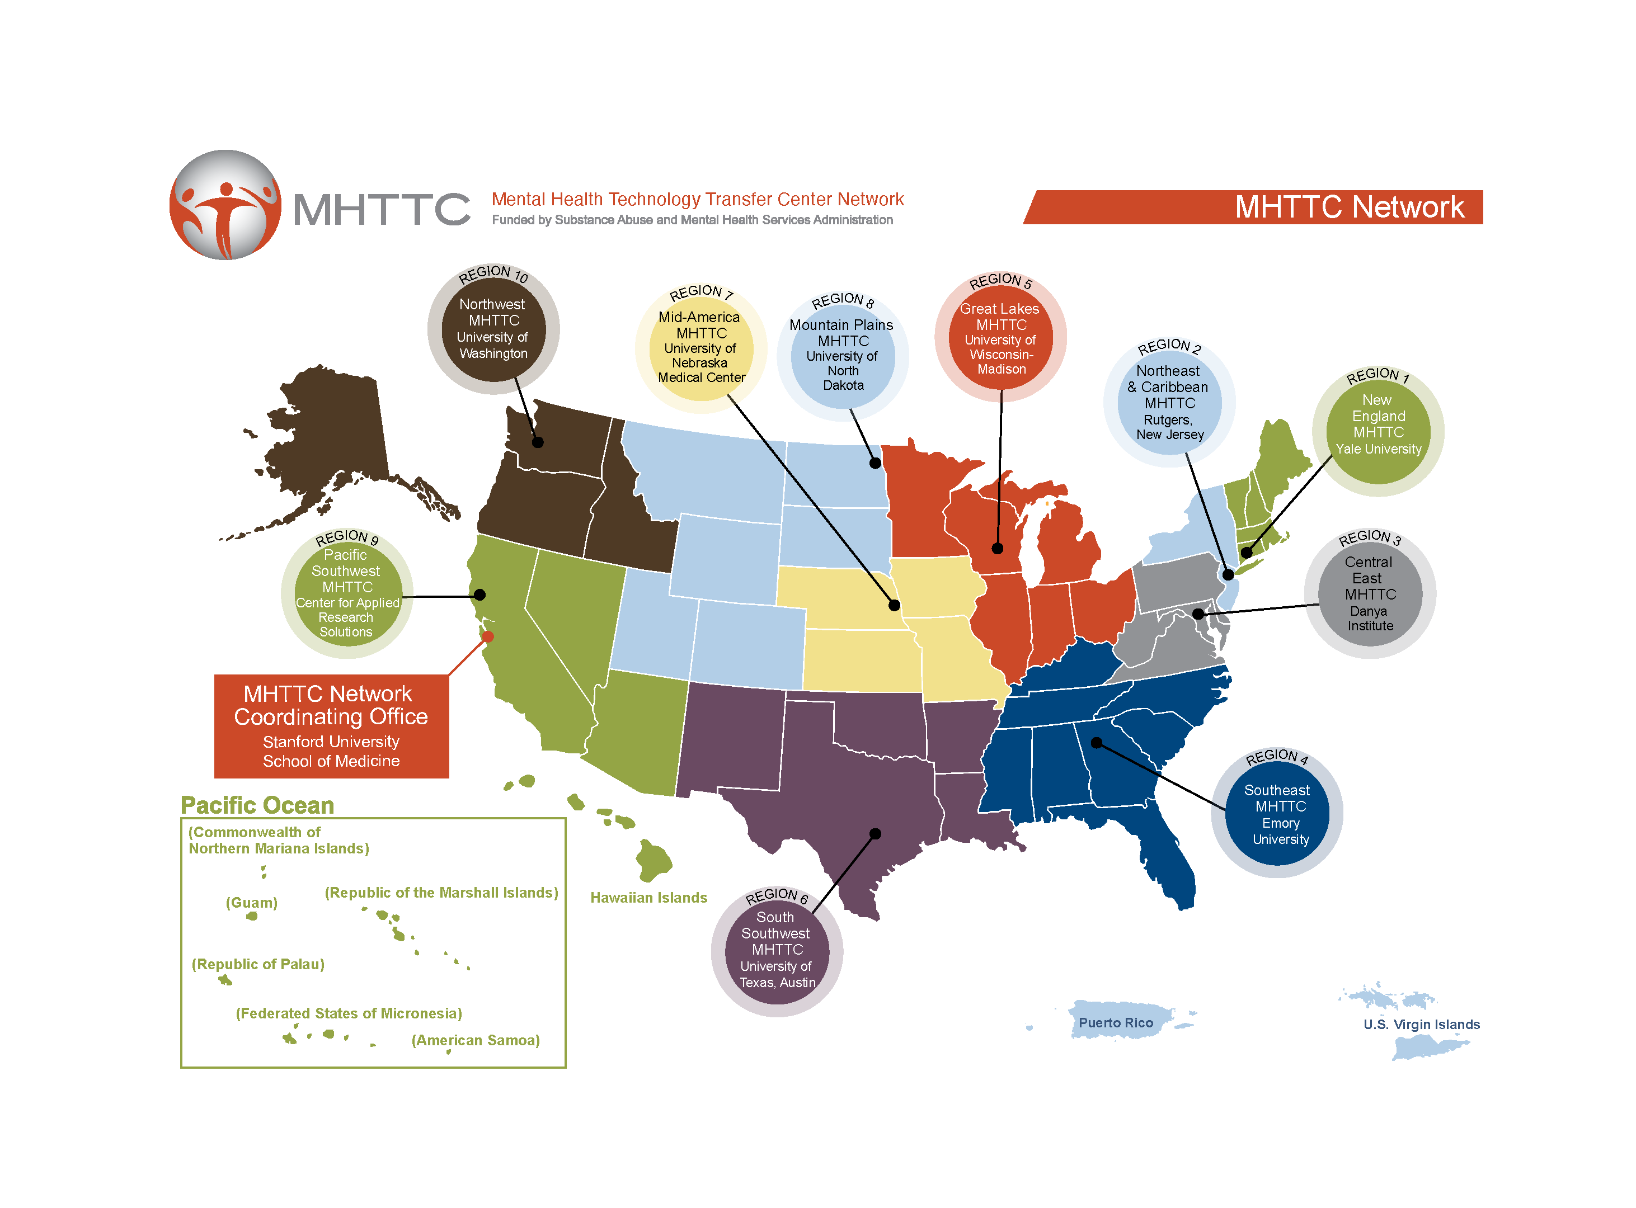
Established in 2018 with funding from the Substance Abuse and Mental Health Services Administration (SAMHSA)
10 Regional Centers
Network Coordinating Office

Slide 6
Mid-America MHTTC Project Director: Dr. Brandy Clarke
SAMHSA grant awarded to Dr. Joseph Evans at Munroe-Meyer Institute out of the University of Nebraska Medical Center
(Grant #: H79SM081769)
Continuum of training and technical assistance in evidence-based practice and mental health services across NE, IA, KS, MO

Slide 7
Specialized Training and Technical Assistance
Integrating behavioral health in primary care.
School mental health.
Community treatment approaches for severe mental illness.
Behavioral health workforce development.

Slide 8
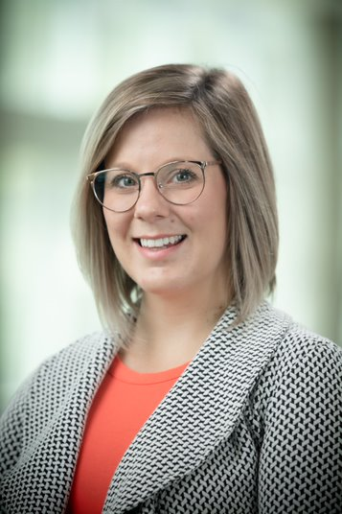
Who We Are
Mid-America MHTTC SMH Team Munroe Meyer Institute University of Nebraska Medical Center
Presenters
Erika Franta, PhD, LP
Hannah West, PhD, LP, BCBA

Slide 9
Who do we have here?
School Nurses
School Mental Health Professionals
Educators
Anyone else?
Notes:
Britt

Slide 10
18 million children
exhibit
social, emotional, & behavioral needs (figure is probably higher with COVID)
70 – 80%
of those children receive school-based services
20%
receive needed services

Slide 11
MTSS/Educator stress
If educators are overly stressed, trying to implement school-based mental health supports and SEL is like building a house on a crumbling foundation.

Slide 12
Teacher Stress Impacts Students
Teachers who are stressed demonstrate greater negative interactions with students:
Sarcasm
Aggression
Responding negatively to mistakes
Teacher Stress
Student Misbehavior
Classrooms led by a teacher who reported feeling overwhelmed (high burnout) had students with much higher cortisol levels
Teacher Stress
Citations:
www.schoolmentalhealth.org
Oberle & Schonert-Reichl (2016).
40

Slide 13
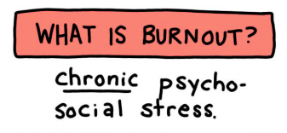
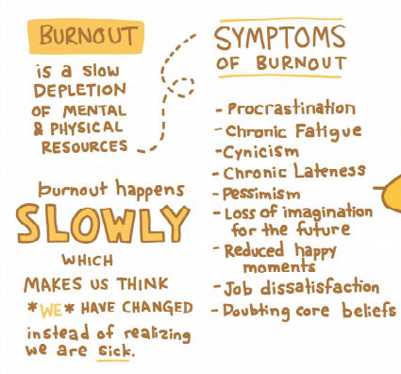
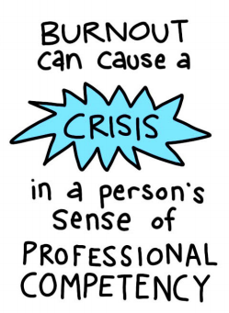
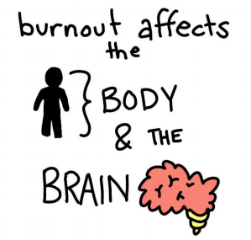
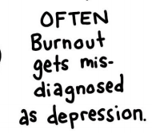
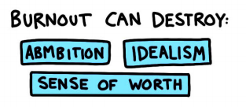
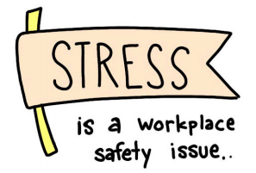
@lindsaybraman
Notes:
Burnout is a term that has been used since the 1970s describe the physical and emotional exhaustion that workers can experience when they have low job satisfaction and feel powerless and overwhelmed at work. However, burnout does not necessarily mean that our view of the world has been damaged, or that we have lost the ability to feel compassion for others.
physical, emotional, or mental exhaustion accompanied by decreased motivation, lowered performance, and negative attitudes toward oneself and others. It results from performing at a high level until stress and tension, especially from extreme and prolonged physical or mental exertion or an overburdening workload, take their toll. The word was first used in this sense in 1975 by U.S. psychologist Herbert J. Freudenberger (1926–1999) in referring to workers in clinics with heavy caseloads. Burnout is most often observed in professionals who work in service-oriented vocations (e.g., social workers, teachers, correctional officers) and experience chronic high levels of stress. It can be particularly acute in therapists or counselors doing trauma work, who feel overwhelmed by the cumulative secondary trauma of witnessing the effects. Burnout is also experienced by athletes when continually exposed to stress associated with performance without commensurate rewards or rest (APA Dictionary of Psychology)

Slide 14
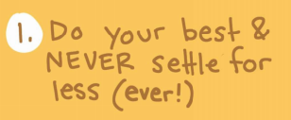
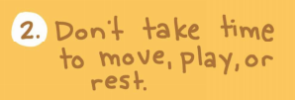
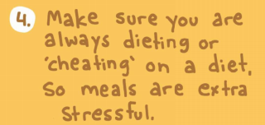
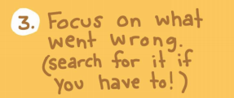
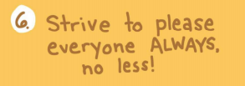
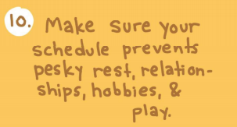
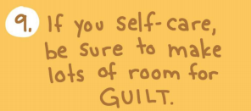
Notes:
Pause, “How many of you recognize these in yourselves, friends, community?”

Slide 15
How do we best support our students?

Slide 16
By supporting the educators that work with them.

Slide 17
***NEW self-care slide

Slide 18
It’s crucial that when addressing the social-emotional competence of students and educators, we do so not in a vacuum, but in the larger socio-political context.

Slide 19
There is no such thing as a “one size fits all” approach to well-being.

Slide 20
How do Educators Cope?
Social support from colleagues, family members, and friends
Self-defined boundaries for work-life balance
Prioritize individual wellness activities
(RAND, 2022)

Slide 21
What Do Educators Nation-Wide Need?
Systems-wide changes to support the well-being of educators and staff
Grow the educator workforce
(RAND, 2022)

Slide 22
How have we worked to support educator well-being in Mid-America?

Slide 23
The Adult Resilience Curriculum (ARC)

Slide 24
Acknowledgements

Slide 25
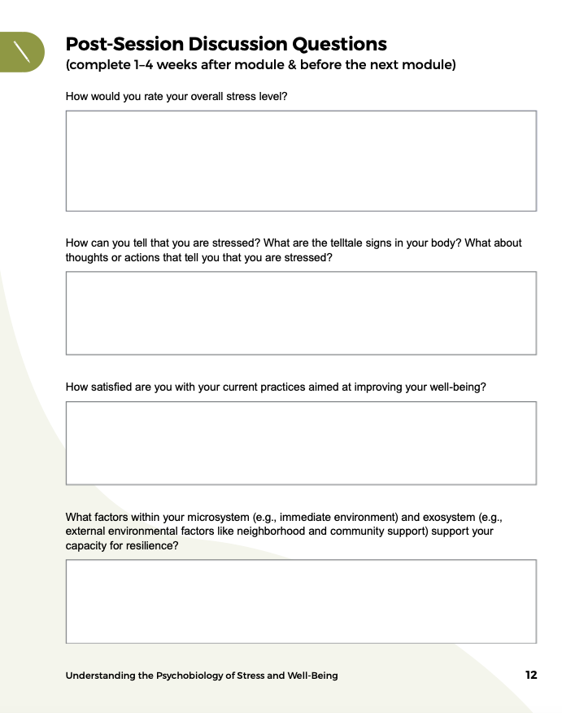
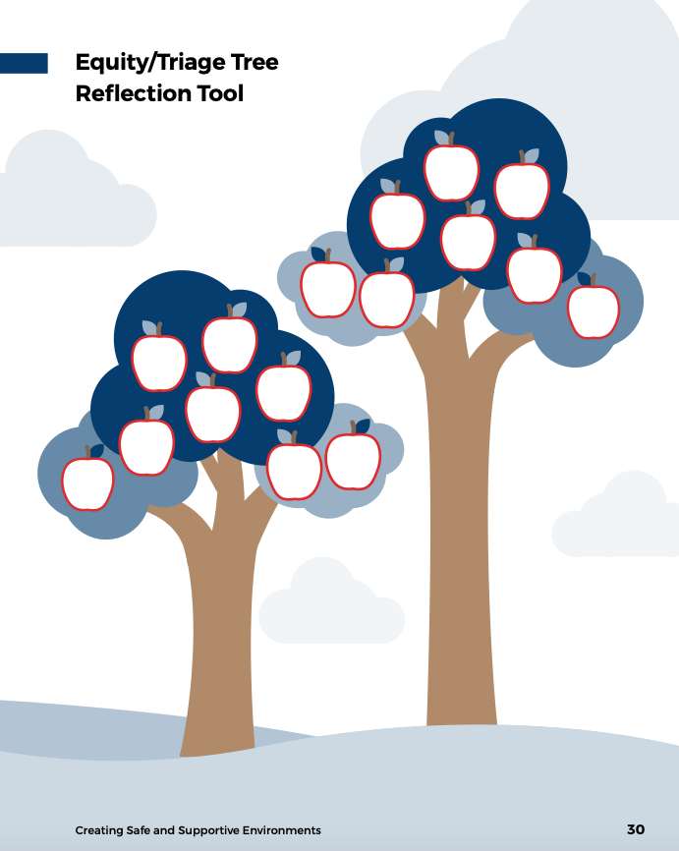
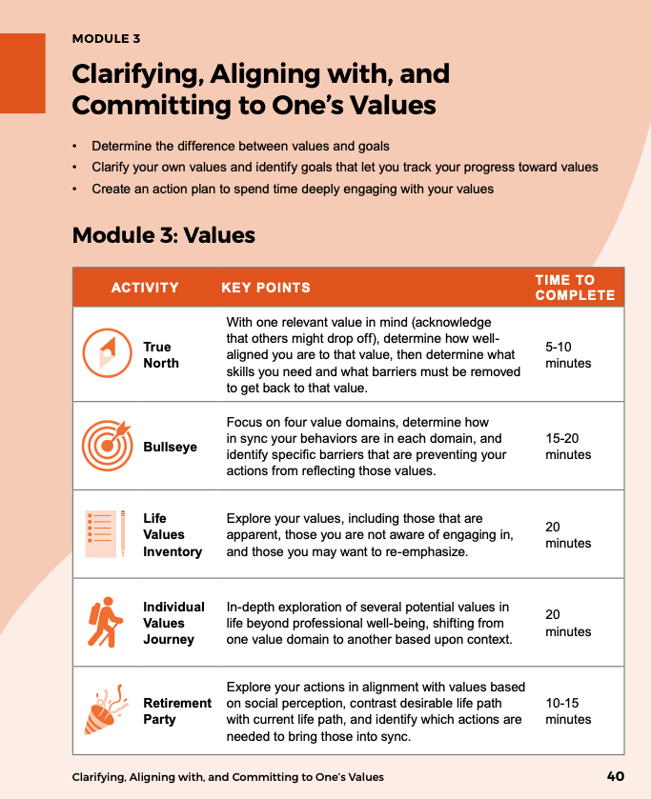
ARC for Professionals Interactive Workbook
https://mhttcnetwork.org/centers/mid-america-mhttc/product/adult-resilience-curriculum-arc-workbook-professionals

Slide 26
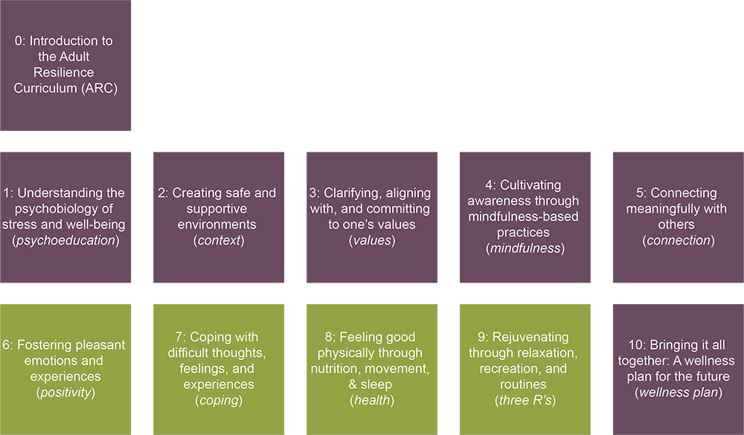
The ARC Modules
Notes:
Module 1 is all about understanding the impact of stress on our lives and work. In this module we normalize stress and discuss that it sometimes necessary for optimal performance, so the goal of well-being isn’t the complete elimination of stress but finding the proper balance.
Module 2 is very important because it discusses how to refine or build a system that prioritizes and supports a culture of well-being. We will be discussing this module more in a minute.
Module 3 focuses on identifying and living out our values. We will be discussing this module more in a minute.
Module 4 builds and practices mindfulness skills. This module does not just cover "breathing," but being intentional or "mindful" in our everyday actions.
Module 5 helps us identify relationships that we want to have with other people and connecting meaningfully with others.
Module 6 helps us identify ways we can foster pleasant emotions and experiences because my goodness I know, for me, it takes a lot of energy to foster pleasant emotions after a long day of working with middle school students :)
Module 7 utilizes cognitive-behavioral and emotion-focused strategies that can be used when we experience difficult or unhelpful thoughts, feelings, and experiences.
Module 8 focuses on the importance of taking care of our physical selves.
Module 9 focuses on building routines that allow ourselves to live the life that we want, despite all of the chaos that may be around us. We will be learning more about this in a moment.
And finally, Module 10 is building a wellness plan that works for you now and can be modified in the future as life changes. We will cover this one more in a moment as well.

Slide 27
The ARC Wellness Plan
Module Review
Wellness is Action and Ongoing
Wellness Plan

Slide 28
Training and Technical Assistance by Mid-America MHTTC
Live Training (Virtual, In-Person)
Monthly Emails
Leadership Workshops
Training of Trainers

Slide 29
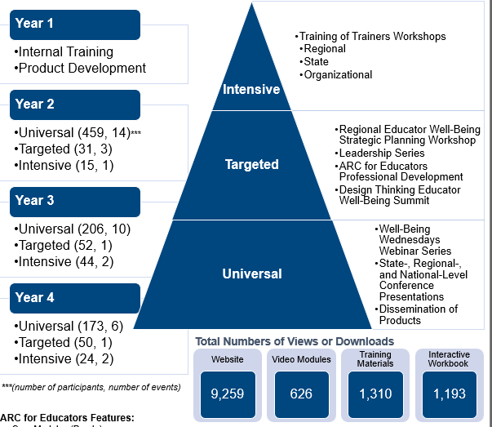

Slide 30
Lessons Learned
Higher engagement when built into existing programming and structure
Overall, positive feedback regarding content, training method, and application of the materials with trainees, trainers, and leaders
Reported utility of the Hexagon Tool with Leaders in make decision regarding Educator Well-Being Programming

Slide 31
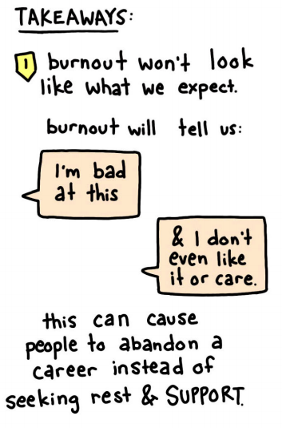
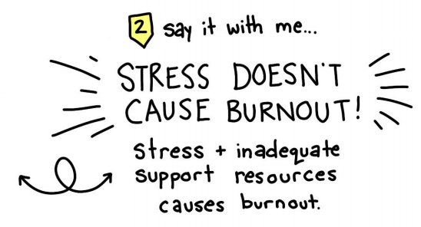
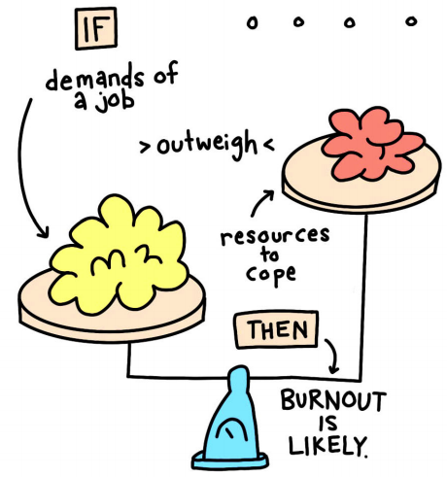
@lindsaybraman

Slide 32
So we do the things to support our own wellbeing
AND
We have to work for systems-level change

Slide 33
Additional School Mental Health Resources & Opportunities

Slide 37
Request Technical Assistance

Slide 38
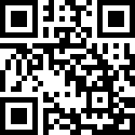
Take Our Survey
Follow the link
https://ttc-gpra.org/P?s=874886
OR
Use your smartphone’s Camera app to scan the QR code

